Slide 1

Evaluating Spectral Embedding Model Using Supervised and Unsupervised Models
CMSC 635 PROJECT
TEAM-5

Slide 2
Objectives
To evaluate the performance of the different embedded representation of data using different machine learning models.

Slide 3
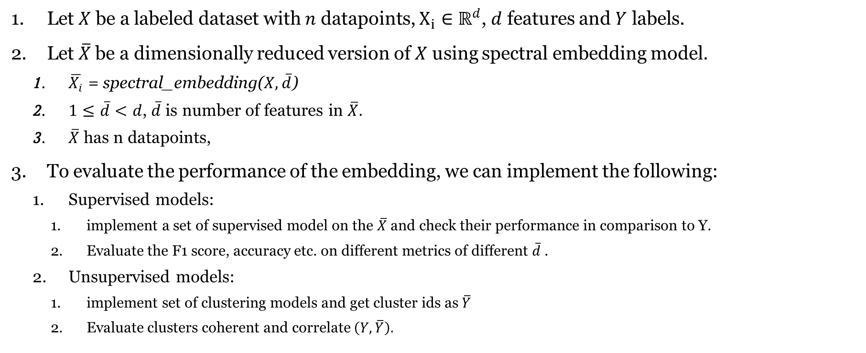
Framework
Let $X$ be a labeled dataset with $n$ datapoints, $X_{i}∈ℝ^{d}$, $d$ features and $Y$ labels.
Let $\overline{X}$be a dimensionally reduced version of $X$ using spectral embedding model.
$\overline{X_{i}}$ = spectral_embedding($X,\overline{d}$)
$1≤\overline{d}<d$, $\overline{d}$is number of features in $\overline{X}.$
$\overline{X}$has n datapoints,
To evaluate the performance of the embedding, we can implement the following:
Supervised models:
implement a set of supervised model on the $\overline{X}$ and check their performance in comparison to Y.
Evaluate the F1 score, accuracy etc. on different metrics of different $\overline{d}$.
Unsupervised models:
implement set of clustering models and get cluster ids as $\overline{Y}$
Evaluate clusters coherent and correlate $\left(Y,\overline{Y}\right).$

Slide 4
Best classifiers (works internally)
Random Forest: Random forest is an ensemble learning algorithm that builds multiple decision trees and selects the best features for each tree based on the reduction of impurity in the nodes. It is a popular algorithm for feature selection and classification tasks due to its ability to handle high-dimensional data and nonlinear relationships.
Gradient Boosting: Gradient Boosting is an ensemble learning algorithm that builds multiple decision trees sequentially, each tree learning from the mistakes of the previous tree. The algorithm automatically selects the best features to use in each tree based on their importance. It is particularly useful when there are many features with complex relationships.
L1-Regularized Logistic Regression: L1-regularized logistic regression is a linear classification algorithm that performs L1 regularization, which can shrink some of the coefficients to zero, effectively performing feature selection. It is commonly used for high-dimensional feature selection problems.
Recursive Feature Elimination (RFE) : RFE is a feature selection algorithm that works by recursively removing features and building a model using the remaining features until the optimal set of features is achieved. It is a simple and effective method for feature selection in classification problems.
Elastic Net: Elastic Net is a linear regression algorithm that performs both L1 and L2 regularization. This allows the algorithm to perform both feature selection and feature shrinkage at the same time. It is particularly useful when the number of features is much larger than the number of observations.

Slide 5
Random Forest
from sklearn.datasets import load_iris
from sklearn.ensemble import RandomForestClassifier
# Load the iris dataset
iris = load_iris()
# Create a random forest classifier object
rfc = RandomForestClassifier()
# Fit the random forest classifier on the iris dataset
rfc.fit(iris.data, iris.target)
# Print the feature importance scores
print(rfc.feature_importances_)

Slide 6
Sensitivity and Specificity
from sklearn.metrics import confusion_matrix
# True labels of the test set
y_true = [1, 0, 1, 1, 0, 1, 0, 0, 1, 1]
# Predicted labels of the test set
y_pred = [1, 0, 1, 0, 0, 1, 1, 0, 1, 1]
# Calculate the confusion matrix
tn, fp, fn, tp = confusion_matrix(y_true, y_pred).ravel()
# Calculate sensitivity and specificity
sensitivity = tp / (tp + fn)
specificity = tn / (tn + fp)
print("Sensitivity:", sensitivity)
print("Specificity:", specificity)

